Slide 1
Fundamentals of High Voltage Techniques

Slide 2
Fundamentals of High Voltage Techniques
6 MV
There’s the man ☺

Slide 3
Fundamentals of High Voltage Techniques
Lightning impulse
voltage
Switching impulse
voltage

Slide 4
Fundamentals of High Voltage Techniques
QUESTION ??? ☺
How does front chopping arise
Why is it relevant

Slide 5
Fundamentals of High Voltage Techniques
We must discuss
how this works !

Slide 6
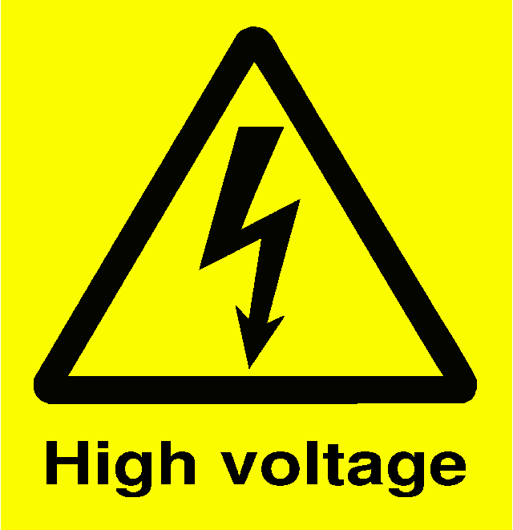
Fundamentals of High Voltage Techniques
Utilization factor (efficiency) and discharge
energy
For circuit b, simplified

Slide 7
Fundamentals of High Voltage Techniques

Slide 8
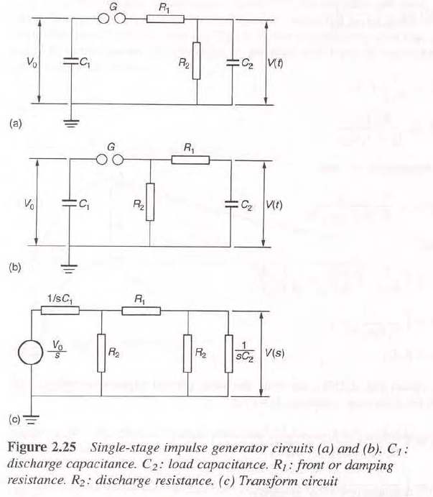
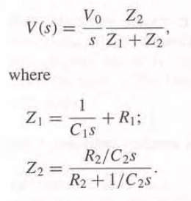
Fundamentals of High Voltage Techniques
Laplace domain ☺

Slide 9
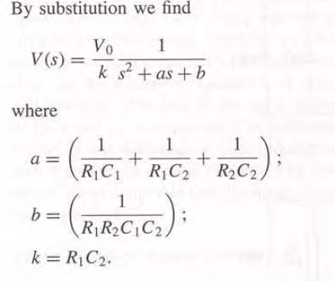
Fundamentals of High Voltage Techniques
Output voltage
Depends on chosen components in the impulse generator and the ”load”.

Slide 10
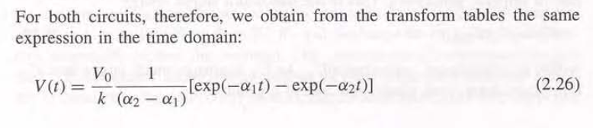
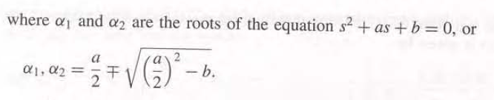
Fundamentals of High Voltage Techniques
We recognize the output voltage to be the difference
between two exponentials

Slide 11
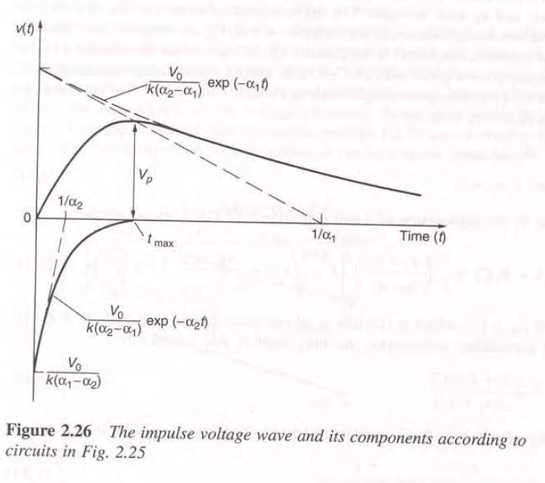
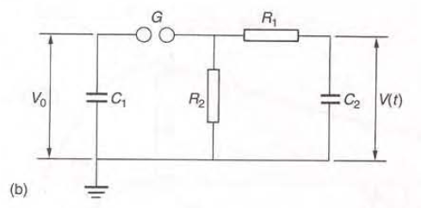
Fundamentals of High Voltage Techniques
Output impulse voltage

Slide 12
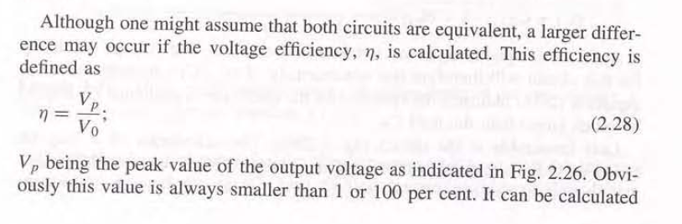
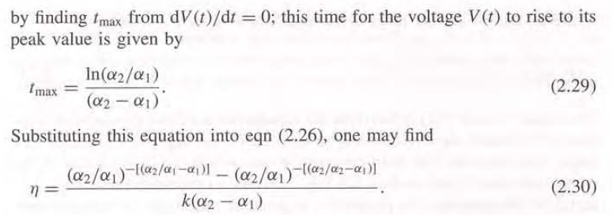
Fundamentals of High Voltage Techniques
WHY – obviously? ☺

Slide 13
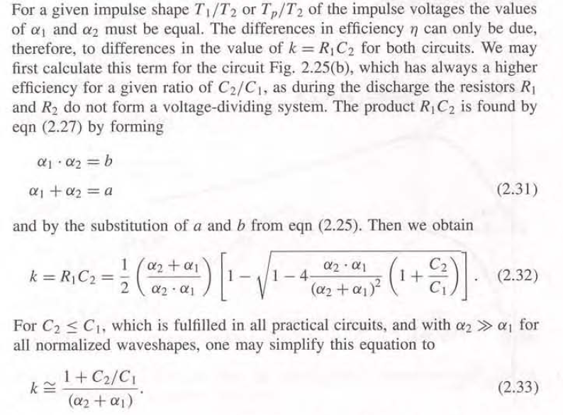
Fundamentals of High Voltage Techniques

Slide 14
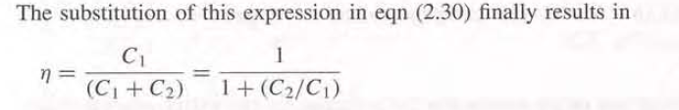
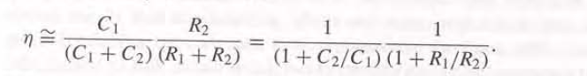
Fundamentals of High Voltage Techniques
For circuit b)
For circuit a)
Voltage dividing because of resistor R2 location

Slide 15
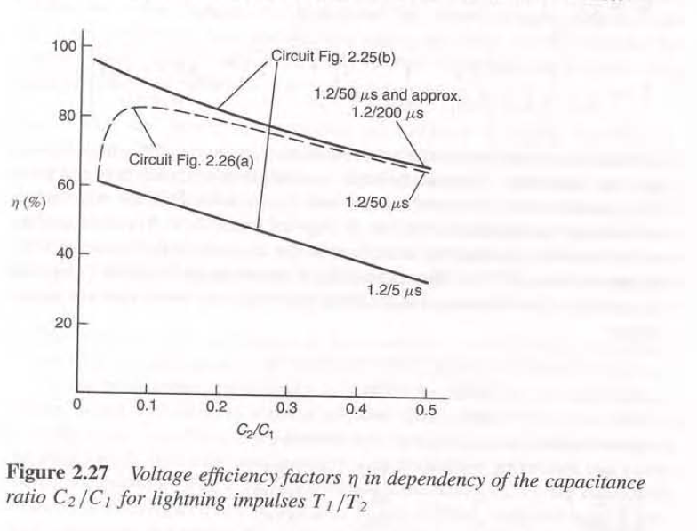
Fundamentals of High Voltage Techniques

Slide 16
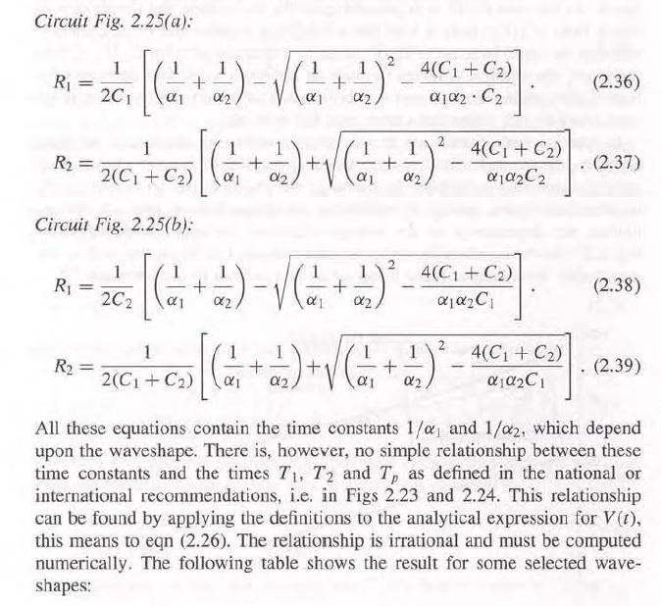
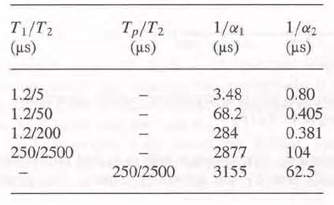
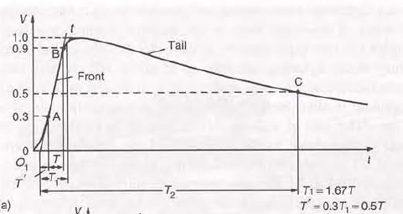
Fundamentals of High Voltage Techniques

Slide 17
Fundamentals of High Voltage Techniques
Simplified way ☺

Slide 18
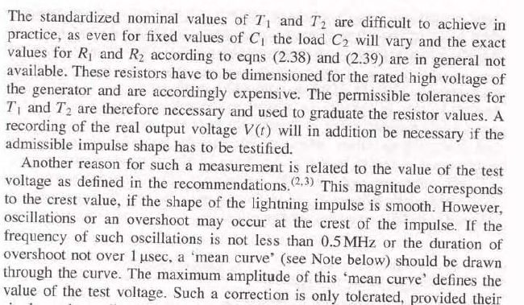
Fundamentals of High Voltage Techniques

Slide 19
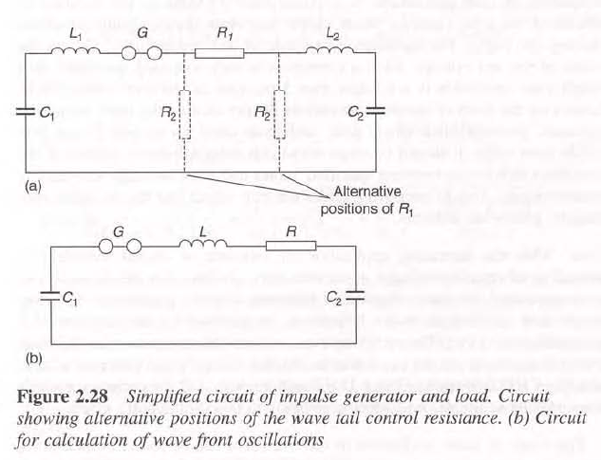
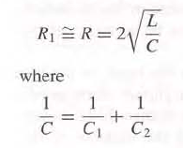
Fundamentals of High Voltage Techniques
For a non-oscillatory
behavior.
Critically damped!

Slide 20
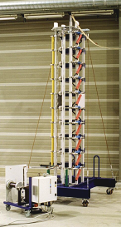
Fundamentals of High Voltage Techniques

Slide 21
Fundamentals of High Voltage Techniques

Slide 22

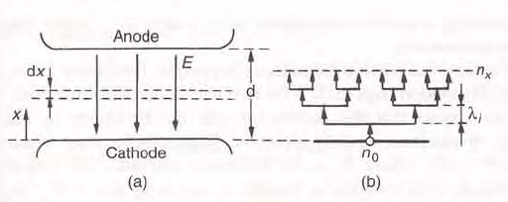
Fundamentals of High Voltage Techniques

Slide 23
Fundamentals of High Voltage Techniques
So for impulse voltages
we ALWAYS mean the
50% breakdown
voltage when using
breakdown voltage
tables or when nothing
else is stated !

Slide 24
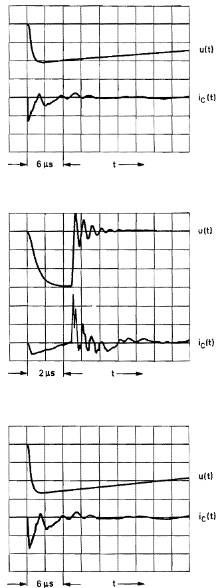
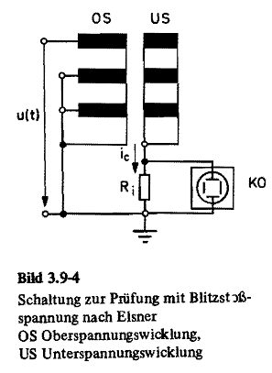
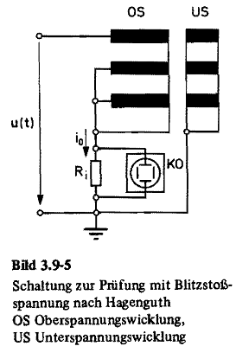
Fundamentals of High Voltage Techniques
Tell a story about the testing of
large Power transformers ☺
Reduced wave
Chopped wave
Control with
full wave

Slide 25
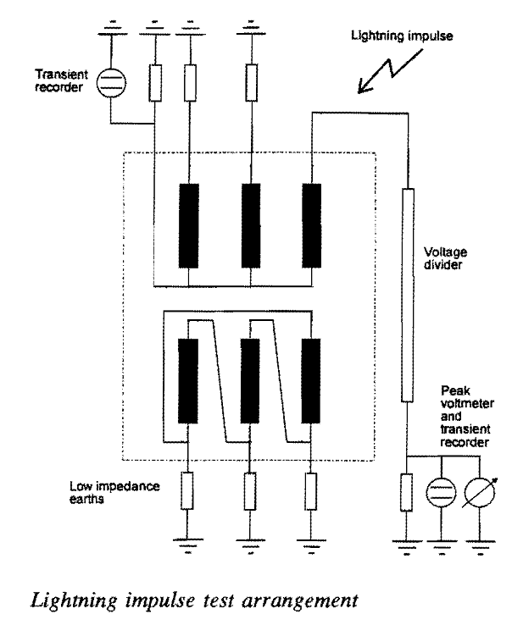
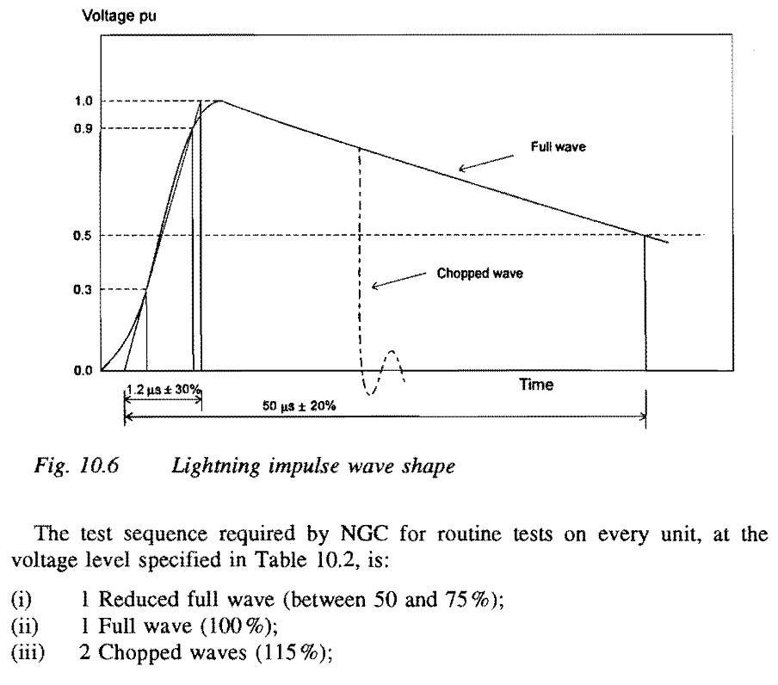
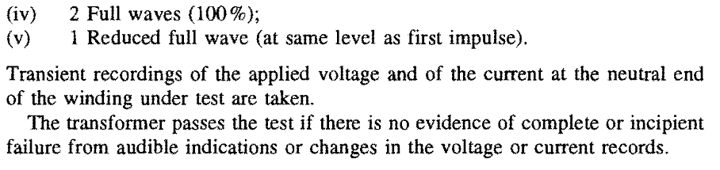
Fundamentals of High Voltage Techniques

